Slide 1
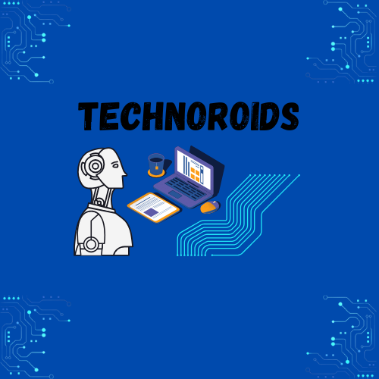
Team technoroids
Track. Analyze. Improve Student Engagement.
By : FRANCIS KYLE DELA TINA & JAN GERARD ABELLA

Slide 2

Class Pulse
Track. Analyze. Improve Student Engagement.

Slide 3
What is Class Pulse?
An app to monitor student engagement in online classes.
Tracks login frequency, material usage, participation, quizzes, and submissions.
Visualizes data in graphs and summaries for both teachers and students.

Slide 4
Why we built it
Online learning made student engagement harder to track.
Teachers lack real-time insight into class participation.
Students often unaware of their own study patterns.
Class Pulse bridges this gap with clear data and visuals.

Slide 5
What is Class Pulse?
An app to monitor student engagement in online classes.
Tracks login frequency, material usage, participation, quizzes, and submissions.
Visualizes data in graphs and summaries for both teachers and students.

Slide 6
Key Features
📊 Real-Time Engagement Analyzer
📅 Weekly Activity Summaries
📈 Dashboards for Teachers
✅ Personalized Student Feedback
📥 Exportable Reports and Alerts

Slide 7
ENGagement analyzer details
Tracks logins, time spent on materials, quiz attempts.
Measures discussion activity (posts/replies).
Assignment uploads and deadlines met.
All data linked to students and visualized.

Slide 8
Design Alternatives
1. Card-Based Overview – Simple, scannable, mobile-friendly.
2. Timeline Tracker – Visual log of daily engagement patterns.
3. Analytics Dashboard – Graph-heavy, filterable for deep insights.

Slide 9
UI MOCKUPS
Mobile design: clean, modern, dashboard-focused
Colors: Blue tones for calm and trust
Visuals: Graphs, color codes for engagement status
UX: Designed for both students and instructors

Slide 10
Storyboard Flow
1. Login Screen
2. Dashboard Overview
3. Engagement Graphs
4. Class Participation Summary
5. Student Profile View
6. Settings and Alerts

Slide 11
Menu & Settings
Menu includes:
Dashboard
Classes
Engagement
Profile
Settings
Settings include:
Change profile
Toggle notifications
Export data
Theme/Language options

Slide 12
Evaluation Plan
Users: Students and Teachers from target audience
Tasks: Check dashboard, analyze student data, send alerts
Methods: Observations, performance time, and satisfaction survey
Feedback collected and used to refine interface

Slide 13
Benefits for teachers
Quickly identify disengaged students
Compare class-wide patterns
Adapt teaching based on trends
Track learning over time

Slide 14
Benefits for students
See their engagement stats
Improve time management
Earn feedback badges
Stay motivated with self-awareness

Slide 15
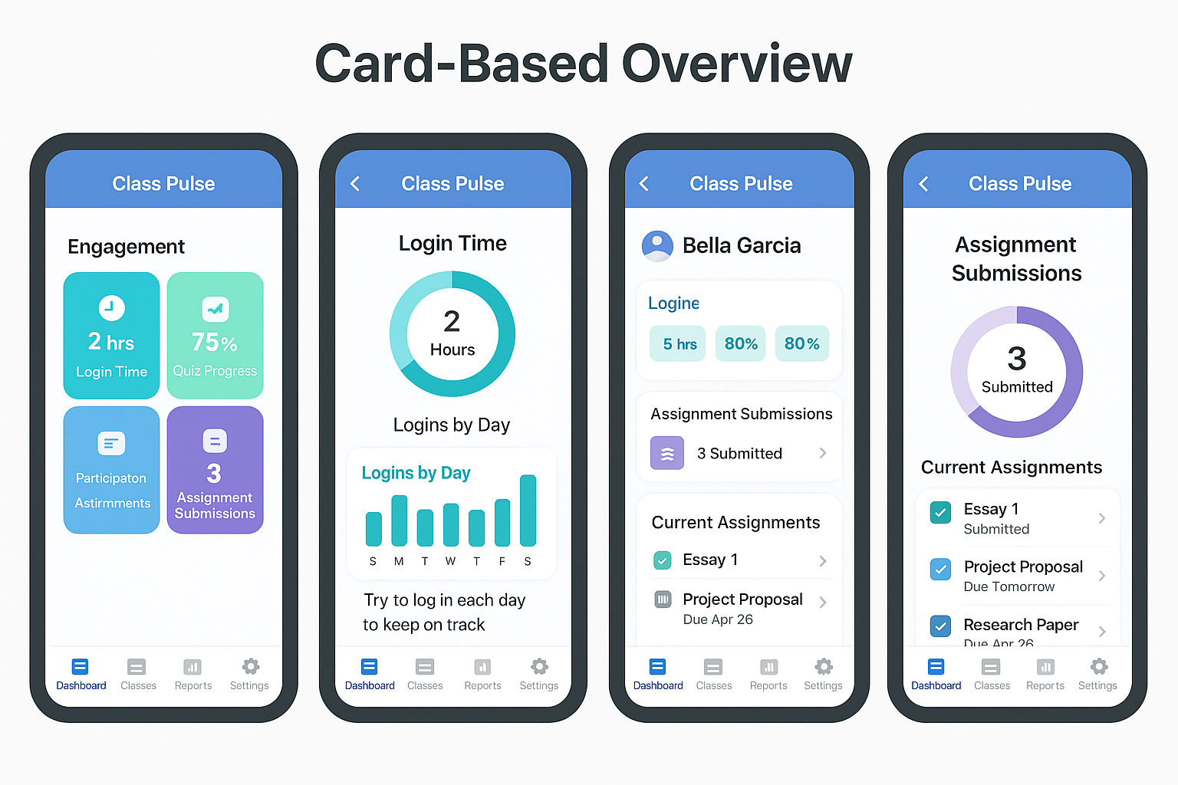
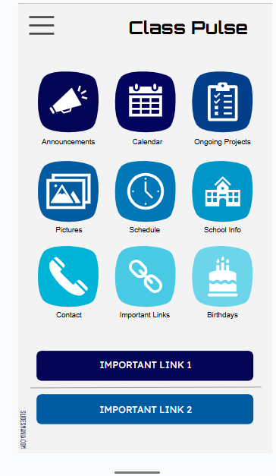
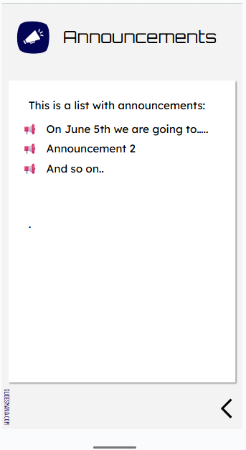
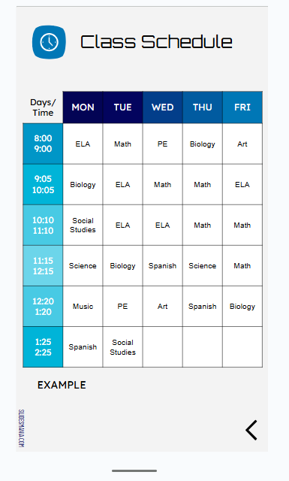
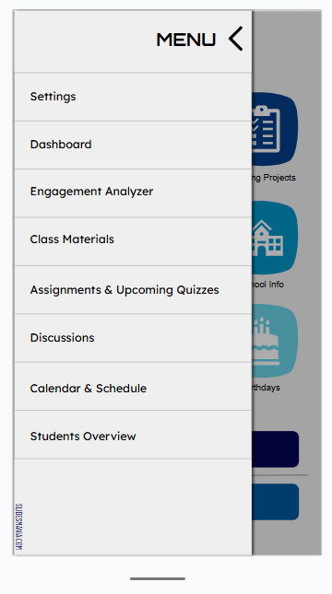
PROTOTYPES AND FINAL DESIGN

Slide 16
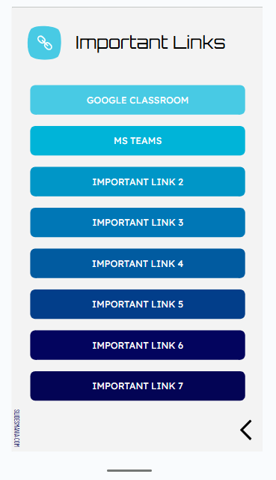
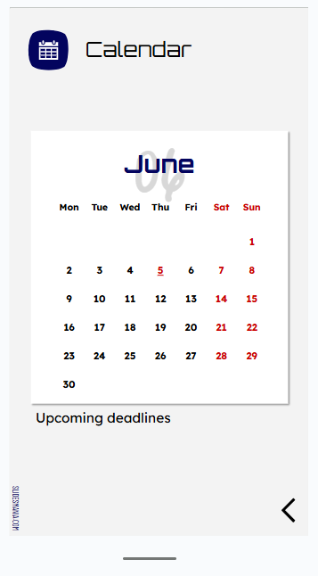
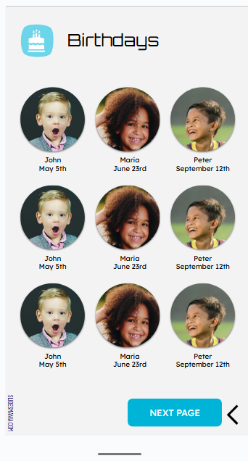
PROTOTYPES AND FINAL DESIGN

Slide 17
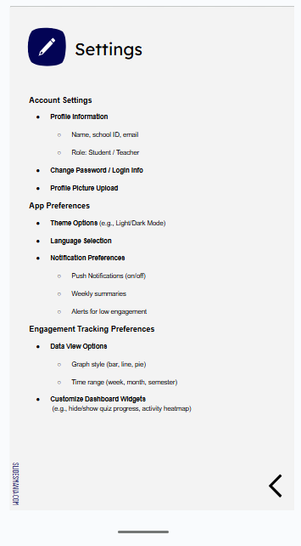
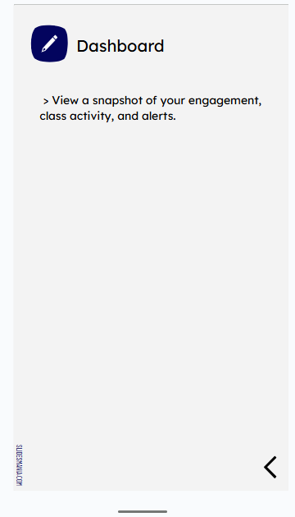
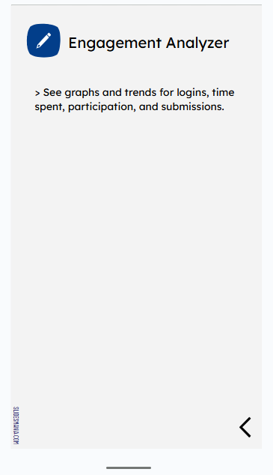
PROTOTYPES AND FINAL DESIGN

Slide 18
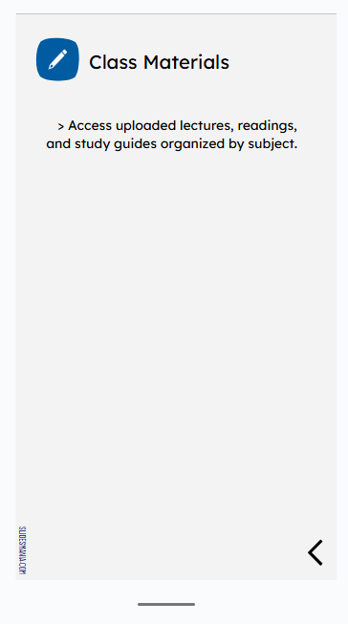
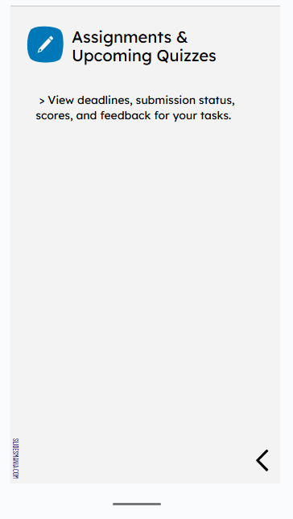
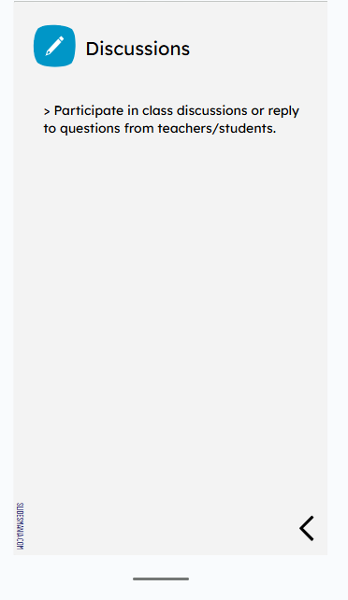
PROTOTYPES AND FINAL DESIGN

Slide 19
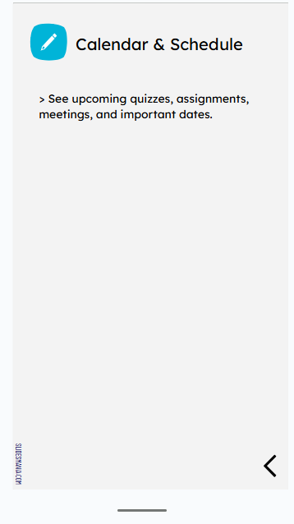
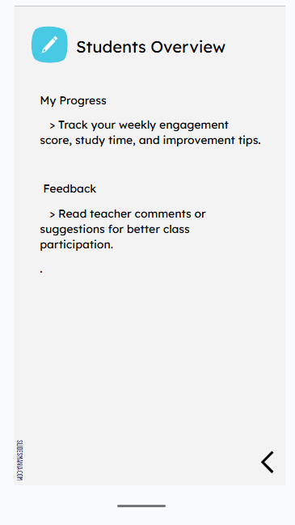
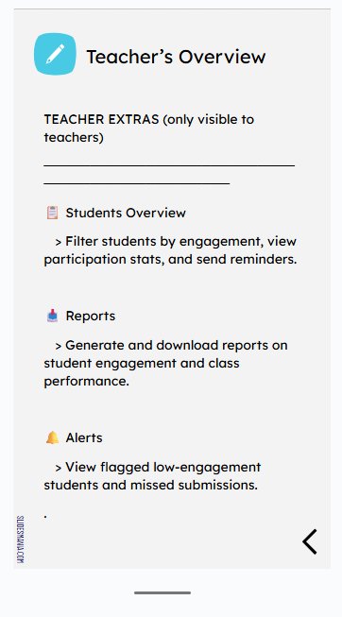
PROTOTYPES AND FINAL DESIGN

Slide 20
Thank you for listening Contact & Deployment :
Emails: fkDelaTina@mcm.edu.ph, jgAbella@mcm.edu.ph
Website hosted via GitHub Pages using index.html

